Slide 1


Theory Of Automata
Syed Faizan Bukhari (21532)
Javeed Ahmed (21521)

Slide 2


Vacuum Cleaner
States
Regular Expression
DFA
Grammar
Code
Output

Slide 3
Introduction:
A vacuum cleaner is a machine that sucks up dirt, dust and other small particles from floors and carpets using suction. It's used to clean houses and other places.

Slide 4
States:
0n 1
0ff 0
Right 2
Left 3
Detect Dirt 4
Suck dirt 5
Rotate 6
Charge 7
Idle State 8

Slide 5
Regular Expression:
Regular expressions are used to generate patterns of strings. A regular expression is an algebraic formula whose value is a pattern consisting of a set of strings, called the language of the expression.

Slide 6
Regular Expression:
1 ( ( 4(5)* ( 24 (5)* + 34 (5)* + 64 (5)* )* 8 ) + ( 01 ) + ( 8 ( 7 )+ 8 ) )* 0
States:
0n 1
0ff 0
Right 2
Left 3
Detect Dirt 4
Suck dirt 5
Rotate 6
Charge 7
Idle State 8

Slide 7
DFA:
A DFA (Deterministic Finite Automaton) is a mathematical model of computation that can be used to recognize patterns in input data. It consists of a finite set of states, a set of input symbols, a transition function, a start state, and a set of accept states.

Slide 8
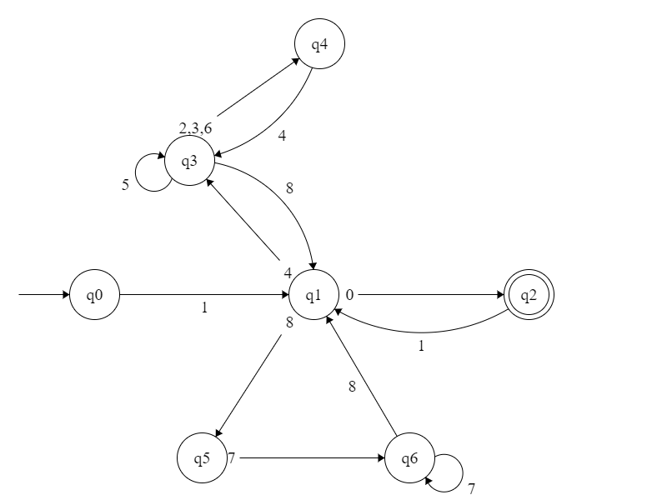
DFA
States:
0n 1
0ff 0
Right 2
Left 3
Detect Dirt 4
Suck dirt 5
Rotate 6
Charge 7
Idle State 8

Slide 9
CFG:
S
A
B
C
D
E
F
States:
0n 1
0ff 0
Right 2
Left 3
Detect Dirt 4
Suck dirt 5
Rotate 6
Charge 7
Idle State 8
1A
0B | 4C | 8E
1A | ε
5C | 2D | 3D | 6D | 8A
4C
7F
7F | 8A

Slide 10
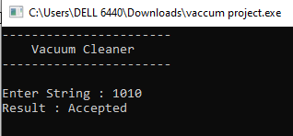
Output:
Accept:

Slide 11
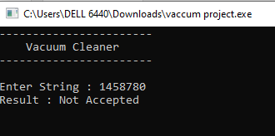
Output:
Not Accept:

Slide 12
Thank You!

